Slide 1
Module 2:
Quantum Algorithms
Prof. Abhishek Dixit
Dept. of Electrical Engineering
IIT Delhi

Slide 2
Outline
Phase kickbacks
Quantum parallelism
Deutsch algorithm
Deutsch-Jozsa algorithm
Bernstein-Vazirani algorithm
Simon’s algorithm

Slide 3
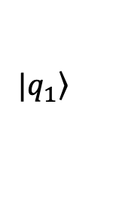
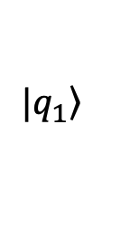
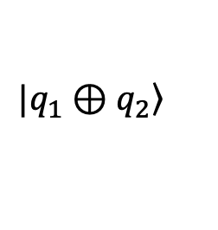
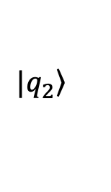
Phase kickbacks
$$|\left.q_{1}\right\rangle$$
$$|\left.q_{1}\right\rangle$$
Control qubit
$$|\left.q_{2}\right\rangle$$
$$|\left.q_{1}⊕q_{2}\right\rangle$$
Target qubit

Slide 4
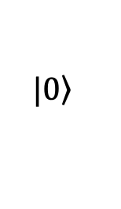
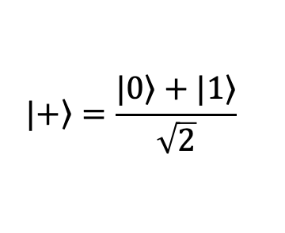
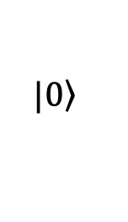
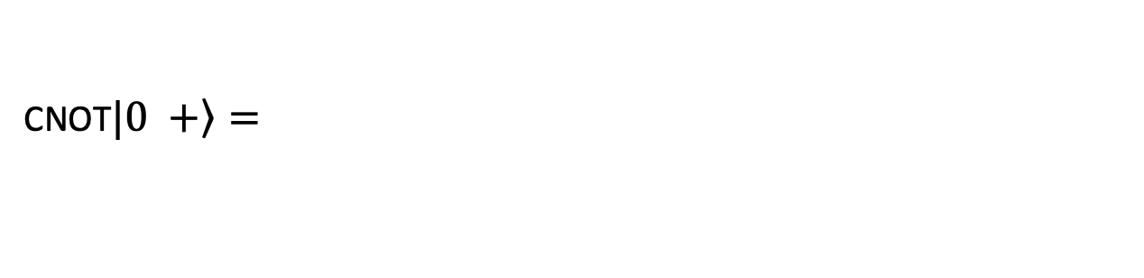
Phase kickbacks
$$|\left.+\right\rangle =\frac{|\left.0\right\rangle +|\left.1\right\rangle }{\sqrt{2}}$$
$$|\left.0\right\rangle$$
Control qubit
H
$$|\left.0\right\rangle$$
Target qubit
CNOT$|\left.0 +\right\rangle =$

Slide 5
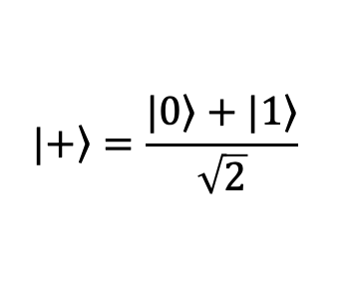
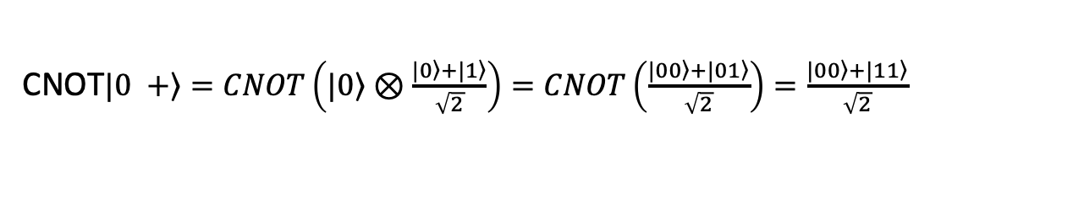
Phase kickbacks
$$|\left.+\right\rangle =\frac{|\left.0\right\rangle +|\left.1\right\rangle }{\sqrt{2}}$$
$$|\left.0\right\rangle$$
Control qubit
H
$$|\left.0\right\rangle$$
Target qubit
CNOT$|\left.0 +\right\rangle =CNOT\left(|\left.0\right\rangle ⊗\frac{|\left.0\right\rangle +|\left.1\right\rangle }{\sqrt{2}}\right)=CNOT\left(\frac{|\left.00\right\rangle +|\left.01\right\rangle }{\sqrt{2}}\right)=\frac{|\left.00\right\rangle +|\left.11\right\rangle }{\sqrt{2}}$

Slide 6
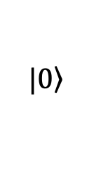
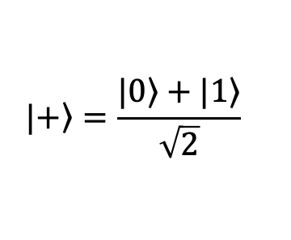
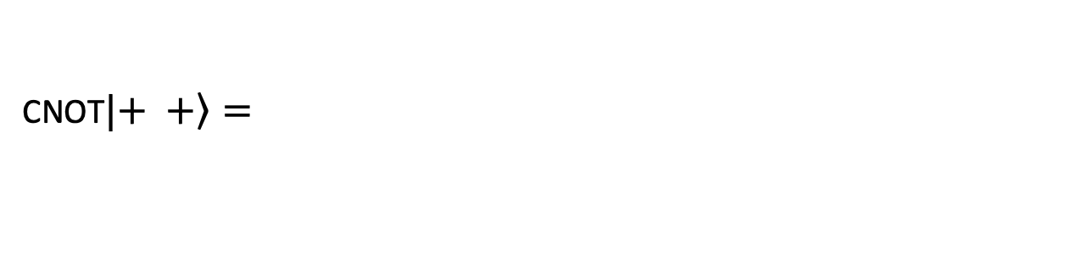
Phase kickbacks
$$|\left.+\right\rangle =\frac{|\left.0\right\rangle +|\left.1\right\rangle }{\sqrt{2}}$$
$$|\left.0\right\rangle$$
Control qubit
H
$$|\left.+\right\rangle =\frac{|\left.0\right\rangle +|\left.1\right\rangle }{\sqrt{2}}$$
$$|\left.0\right\rangle$$
Target qubit
H
CNOT$|\left.+ +\right\rangle =$

Slide 7
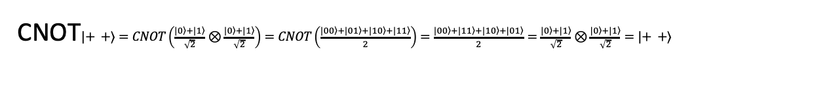
Phase kickbacks
$$|\left.+\right\rangle =\frac{|\left.0\right\rangle +|\left.1\right\rangle }{\sqrt{2}}$$
$$|\left.0\right\rangle$$
Control qubit
H
$$|\left.+\right\rangle =\frac{|\left.0\right\rangle +|\left.1\right\rangle }{\sqrt{2}}$$
$$|\left.0\right\rangle$$
Target qubit
H
CNOT$|\left.+ +\right\rangle =CNOT\left(\frac{|\left.0\right\rangle +|\left.1\right\rangle }{\sqrt{2}}⊗\frac{|\left.0\right\rangle +|\left.1\right\rangle }{\sqrt{2}}\right)=CNOT\left(\frac{|\left.00\right\rangle +|\left.01\right\rangle +|\left.10\right\rangle +|\left.11\right\rangle }{2}\right)=\frac{|\left.00\right\rangle +|\left.11\right\rangle +|\left.10\right\rangle +|\left.01\right\rangle }{2}=\frac{|\left.0\right\rangle +|\left.1\right\rangle }{\sqrt{2}}⊗\frac{|\left.0\right\rangle +|\left.1\right\rangle }{\sqrt{2}}=|\left.+ +\right\rangle$

Slide 8
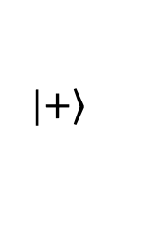
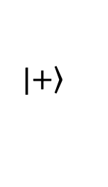
Phase kickbacks
$$|\left.+\right\rangle =\frac{|\left.0\right\rangle +|\left.1\right\rangle }{\sqrt{2}}$$
$$|\left.+\right\rangle$$
$$|\left.0\right\rangle$$
Control qubit
H
CNOT does not always produce entangled states
$$|\left.+\right\rangle =\frac{|\left.0\right\rangle +|\left.1\right\rangle }{\sqrt{2}}$$
$$|\left.0\right\rangle$$
$$|\left.+\right\rangle$$
Target qubit
H
CNOT$|\left.+ +\right\rangle =CNOT\left(\frac{|\left.0\right\rangle +|\left.1\right\rangle }{\sqrt{2}}⊗\frac{|\left.0\right\rangle +|\left.1\right\rangle }{\sqrt{2}}\right)=CNOT\left(\frac{|\left.00\right\rangle +|\left.01\right\rangle +|\left.10\right\rangle +|\left.11\right\rangle }{2}\right)=\frac{|\left.00\right\rangle +|\left.11\right\rangle +|\left.10\right\rangle +|\left.01\right\rangle }{2}=\frac{|\left.0\right\rangle +|\left.1\right\rangle }{\sqrt{2}}⊗\frac{|\left.0\right\rangle +|\left.1\right\rangle }{\sqrt{2}}=|\left.+ +\right\rangle$

Slide 9
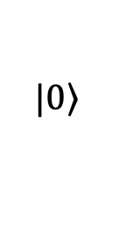
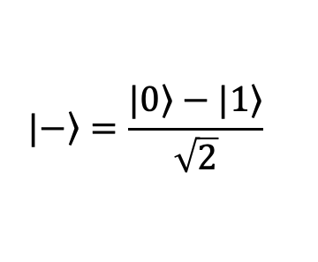
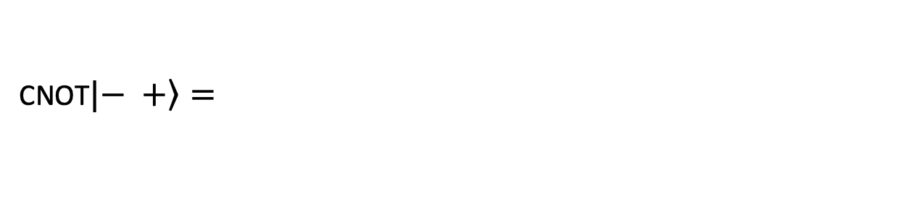
Phase kickbacks
$$|\left.+\right\rangle =\frac{|\left.0\right\rangle +|\left.1\right\rangle }{\sqrt{2}}$$
$$|\left.0\right\rangle$$
Control qubit
H
$$|\left.−\right\rangle =\frac{|\left.0\right\rangle −|\left.1\right\rangle }{\sqrt{2}}$$
$$|\left.0\right\rangle$$
Target qubit
X
H
CNOT$|\left.− +\right\rangle =$

Slide 10
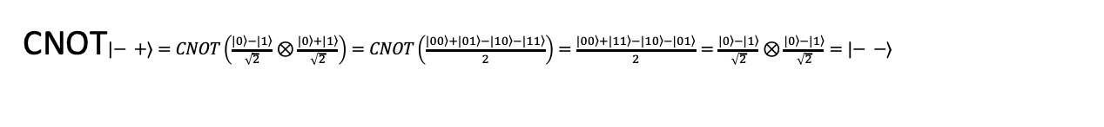
Phase kickbacks
$$|\left.+\right\rangle =\frac{|\left.0\right\rangle +|\left.1\right\rangle }{\sqrt{2}}$$
$$|\left.0\right\rangle$$
Control qubit
H
$$|\left.−\right\rangle =\frac{|\left.0\right\rangle −|\left.1\right\rangle }{\sqrt{2}}$$
$$|\left.0\right\rangle$$
Target qubit
X
H
CNOT$|\left.− +\right\rangle =CNOT\left(\frac{|\left.0\right\rangle −|\left.1\right\rangle }{\sqrt{2}}⊗\frac{|\left.0\right\rangle +|\left.1\right\rangle }{\sqrt{2}}\right)=CNOT\left(\frac{|\left.00\right\rangle +|\left.01\right\rangle −|\left.10\right\rangle −|\left.11\right\rangle }{2}\right)=\frac{|\left.00\right\rangle +|\left.11\right\rangle −|\left.10\right\rangle −|\left.01\right\rangle }{2}=\frac{|\left.0\right\rangle −|\left.1\right\rangle }{\sqrt{2}}⊗\frac{|\left.0\right\rangle −|\left.1\right\rangle }{\sqrt{2}}=|\left.− −\right\rangle$

Slide 11
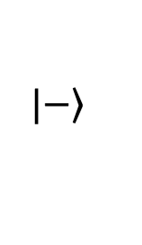
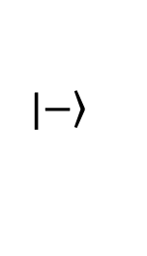
Phase kickbacks
$$|\left.+\right\rangle =\frac{|\left.0\right\rangle +|\left.1\right\rangle }{\sqrt{2}}$$
$$|\left.−\right\rangle$$
$$|\left.0\right\rangle$$
Control qubit
H
$$|\left.−\right\rangle =\frac{|\left.0\right\rangle −|\left.1\right\rangle }{\sqrt{2}}$$
$$|\left.0\right\rangle$$
$$|\left.−\right\rangle$$
Target qubit
X
H
CNOT$|\left.− +\right\rangle =CNOT\left(\frac{|\left.0\right\rangle −|\left.1\right\rangle }{\sqrt{2}}⊗\frac{|\left.0\right\rangle +|\left.1\right\rangle }{\sqrt{2}}\right)=CNOT\left(\frac{|\left.00\right\rangle +|\left.01\right\rangle −|\left.10\right\rangle −|\left.11\right\rangle }{2}\right)=\frac{|\left.00\right\rangle +|\left.11\right\rangle −|\left.10\right\rangle −|\left.01\right\rangle }{2}=\frac{|\left.0\right\rangle −|\left.1\right\rangle }{\sqrt{2}}⊗\frac{|\left.0\right\rangle −|\left.1\right\rangle }{\sqrt{2}}=|\left.− −\right\rangle$

Slide 12
Phase kickbacks
$$|\left.+\right\rangle =\frac{|\left.0\right\rangle +|\left.1\right\rangle }{\sqrt{2}}$$
$$|\left.−\right\rangle$$
$$|\left.0\right\rangle$$
Control qubit
H
Phase kickbacks
$$|\left.−\right\rangle =\frac{|\left.0\right\rangle −|\left.1\right\rangle }{\sqrt{2}}$$
$$|\left.0\right\rangle$$
$$|\left.−\right\rangle$$
Target qubit
X
H
CNOT$|\left.− +\right\rangle =CNOT\left(\frac{|\left.0\right\rangle −|\left.1\right\rangle }{\sqrt{2}}⊗\frac{|\left.0\right\rangle +|\left.1\right\rangle }{\sqrt{2}}\right)=CNOT\left(\frac{|\left.00\right\rangle +|\left.01\right\rangle −|\left.10\right\rangle −|\left.11\right\rangle }{2}\right)=\frac{|\left.00\right\rangle +|\left.11\right\rangle −|\left.10\right\rangle −|\left.01\right\rangle }{2}=\frac{|\left.0\right\rangle −|\left.1\right\rangle }{\sqrt{2}}⊗\frac{|\left.0\right\rangle −|\left.1\right\rangle }{\sqrt{2}}=|\left.− −\right\rangle$

Slide 13
Phase kickbacks
H
H
H
H

Slide 14
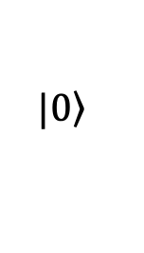
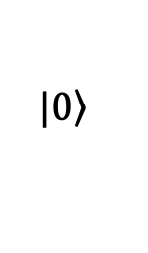
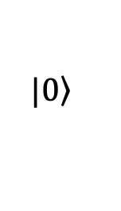
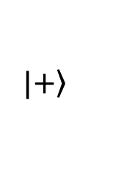
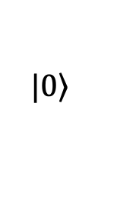
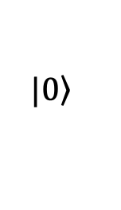
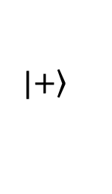
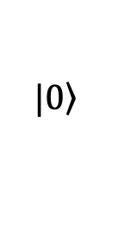
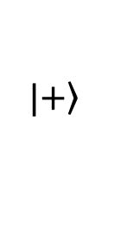
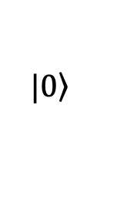
Phase kickbacks
$$|\left.0\right\rangle$$
$$|\left.0\right\rangle$$
$$|\left.0\right\rangle$$
$$|\left.+\right\rangle$$
$$|\left.+\right\rangle$$
$$|\left.0\right\rangle$$
H
H
$$|\left.+\right\rangle$$
$$|\left.+\right\rangle$$
$$|\left.0\right\rangle$$
$$|\left.0\right\rangle$$
$$|\left.0\right\rangle$$
$$|\left.0\right\rangle$$
H
H

Slide 15
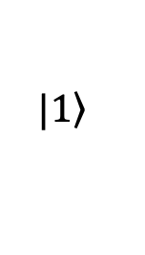
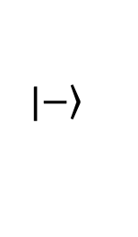
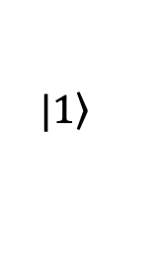
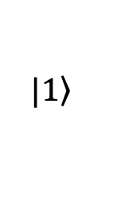
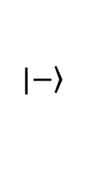
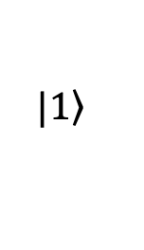
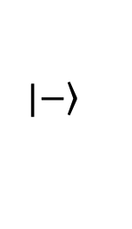
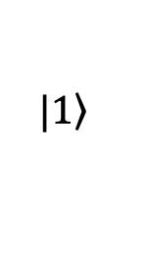
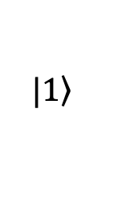
Phase kickbacks
$$|\left.0\right\rangle$$
$$|\left.1\right\rangle$$
$$|\left.0\right\rangle$$
$$|\left.+\right\rangle$$
$$|\left.−\right\rangle$$
$$|\left.1\right\rangle$$
H
H
$$|\left.−\right\rangle$$
$$|\left.−\right\rangle$$
$$|\left.1\right\rangle$$
$$|\left.1\right\rangle$$
$$|\left.1\right\rangle$$
$$|\left.1\right\rangle$$
H
H

Slide 16
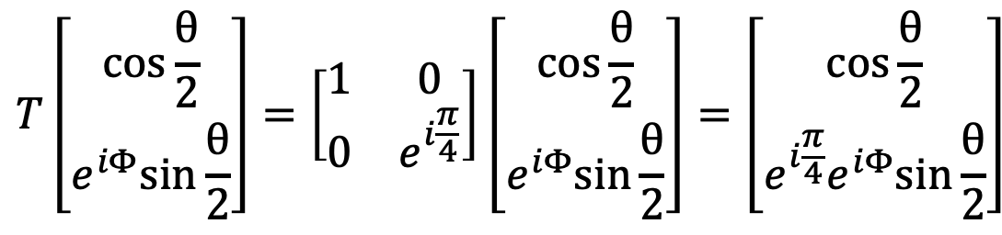
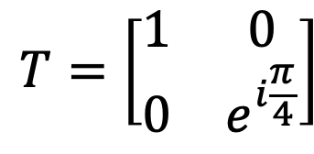
Kickback using Controlled-T gates
$$T=\left[\begin{matrix}1 & 0 \\ 0 & e^{i\frac{π}{4}}\end{matrix}\right]$$
$$T\left[\begin{aligned}\cos{\frac{θ}{2}} \\ e^{iΦ}sin{\frac{θ}{2}}\end{aligned}\right]=\left[\begin{matrix}1 & 0 \\ 0 & e^{i\frac{π}{4}}\end{matrix}\right]\left[\begin{aligned}\cos{\frac{θ}{2}} \\ e^{iΦ}sin{\frac{θ}{2}}\end{aligned}\right]=\left[\begin{aligned}\cos{\frac{θ}{2}} \\ {e^{i\frac{π}{4}}e}^{iΦ}sin{\frac{θ}{2}}\end{aligned}\right]$$

Slide 17
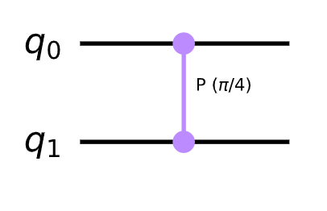
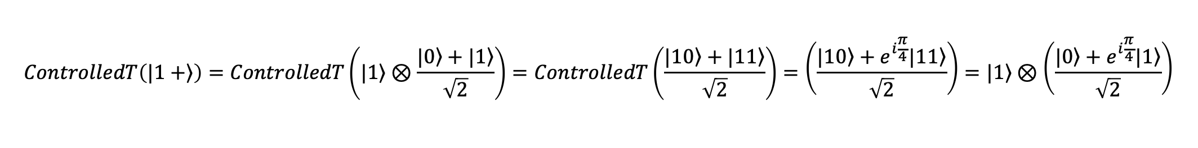
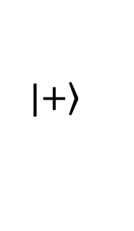
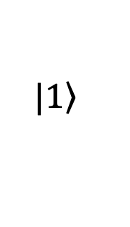
Kickback using Controlled-T gates
$$|\left.+\right\rangle$$
$$|\left.1\right\rangle$$
$$ControlledT\left(|\left.1+\right\rangle \right)=ControlledT\left(|\left.1\right\rangle ⊗\frac{|\left.0\right\rangle +|\left.1\right\rangle }{\sqrt{2}}\right)=ControlledT\left(\frac{|\left.10\right\rangle +|\left.11\right\rangle }{\sqrt{2}}\right)=\left(\frac{|\left.10\right\rangle +e^{i\frac{π}{4}}|\left.11\right\rangle }{\sqrt{2}}\right)=|\left.1\right\rangle ⊗\left(\frac{|\left.0\right\rangle +e^{i\frac{π}{4}}|\left.1\right\rangle }{\sqrt{2}}\right)$$

Slide 18
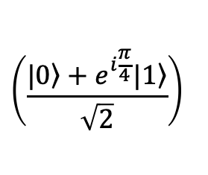
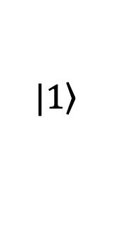
Kickback using Controlled-T gates
$$\left(\frac{|\left.0\right\rangle +e^{i\frac{π}{4}}|\left.1\right\rangle }{\sqrt{2}}\right)$$
$$|\left.+\right\rangle$$
$$|\left.1\right\rangle$$
$$|\left.1\right\rangle$$
$$ControlledT\left(|\left.1+\right\rangle \right)=ControlledT\left(|\left.1\right\rangle ⊗\frac{|\left.0\right\rangle +|\left.1\right\rangle }{\sqrt{2}}\right)=ControlledT\left(\frac{|\left.10\right\rangle +|\left.11\right\rangle }{\sqrt{2}}\right)=\left(\frac{|\left.10\right\rangle +e^{i\frac{π}{4}}|\left.11\right\rangle }{\sqrt{2}}\right)=|\left.1\right\rangle ⊗\left(\frac{|\left.0\right\rangle +e^{i\frac{π}{4}}|\left.1\right\rangle }{\sqrt{2}}\right)$$

Slide 19
Outline
Phase kickbacks
Quantum parallelism
Deutsch algorithm
Deutsch-Jozsa algorithm
Bernstein-Vazirani algorithm
Simon’s algorithm

Slide 20
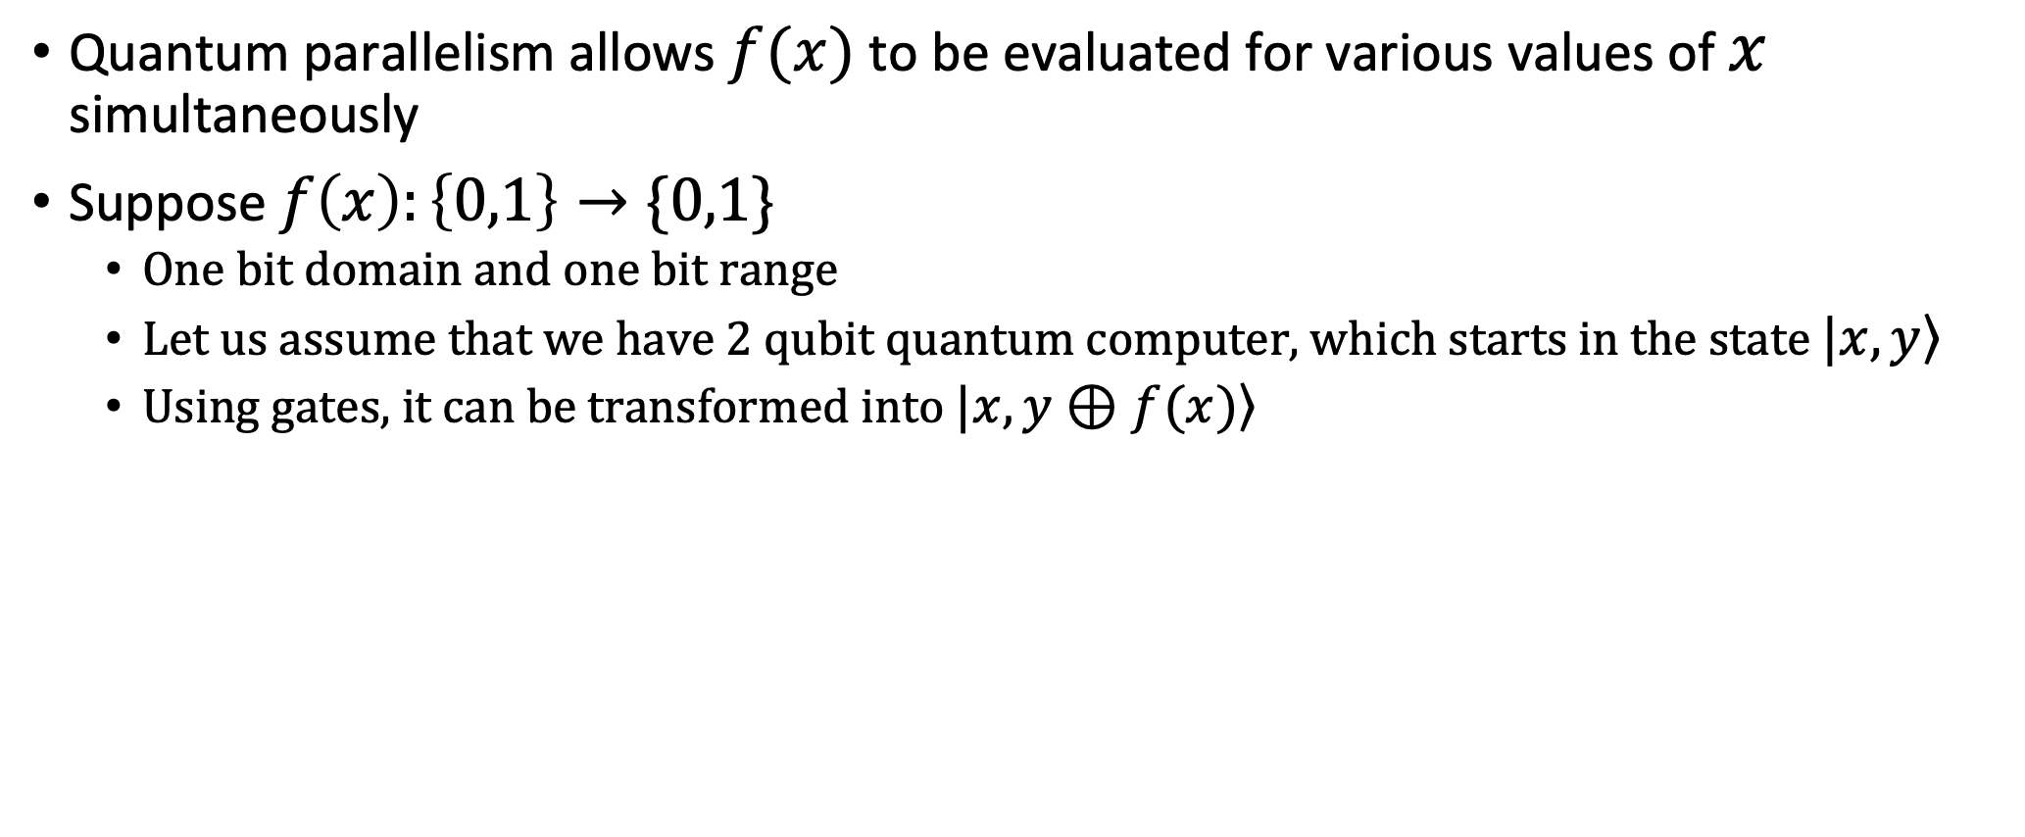
Quantum parallelism
Quantum parallelism allows $f(x)$ to be evaluated for various values of $x$ simultaneously
Suppose $f\left(x\right):\left\{0,1\right\}→\{0,1\}$
  One bit domain and one bit range
  Let us assume that we have 2 qubit quantum computer, which starts in the state $|\left.x,y\right\rangle$
  Using gates, it can be transformed into $|\left.x,y⊕f(x)\right\rangle$

Slide 21






Quantum parallelism
Suppose $f\left(x\right):\left\{0,1\right\}→\left\{0,1\right\}$
0 | 0 | 0 | 0
0 | 1 | 1 | 1
1 | 0 | 1 | 0
1 | 1 | 0 | 1
0 | 0
1 | 1
$$|\left.x \right\rangle$$
$$|\left.x\right\rangle$$
$$U_{f}=\left[\begin{aligned}\begin{matrix}1 & 0 \\ 0 & 0\end{matrix} \begin{matrix}0 & 0 \\ 0 & 1\end{matrix} \\ \begin{matrix}0 & 0 \\ 0 & 1\end{matrix} \begin{matrix}1 & 0 \\ 0 & 0\end{matrix}\end{aligned}\right]$$
$$U_{f}$$
$$|\left.y\right\rangle$$
$$|\left.y⊕f(x)\right\rangle$$

Slide 22





Quantum parallelism
Suppose $f\left(x\right):\left\{0,1\right\}→\left\{0,1\right\}$
$$|\left.x \right\rangle$$
$$|\left.x\right\rangle$$
$$U_{f}$$
$$|\left.y\right\rangle$$
$$|\left.y⊕f(x)\right\rangle$$
We can consider $U_{f}$ to be black box; also known as Oracle

Slide 23


Quantum parallelism
Suppose $f\left(x\right):\left\{0,1\right\}→\left\{0,1\right\}$
$$\frac{|\left.0\right\rangle +|\left.1\right\rangle }{\sqrt{2}}$$
$$U_{f}$$
$$|\left.0\right\rangle$$

Slide 24

Quantum parallelism
Suppose $f\left(x\right):\left\{0,1\right\}→\left\{0,1\right\}$
$$\frac{|\left.0\right\rangle +|\left.1\right\rangle }{\sqrt{2}}$$
$$U_{f}$$
$$|\left.0\right\rangle$$
$$\frac{|\left.f\left(0\right),0\right\rangle +|\left.f\left(1\right),1\right\rangle }{\sqrt{2}}$$

Slide 25

Quantum parallelism
Suppose $f\left(x\right):\left\{0,1\right\}→\left\{0,1\right\}$
$$\frac{|\left.0\right\rangle +|\left.1\right\rangle }{\sqrt{2}}$$
$$U_{f}$$
$$|\left.0\right\rangle$$
$$\frac{|\left.f\left(0\right),0\right\rangle +|\left.f\left(1\right),1\right\rangle }{\sqrt{2}}$$
Remarkable state: different terms contain information about both $f(0)$ and $f(1)$

Slide 26


Quantum parallelism
Suppose $f\left(x\right):\left\{0,1\right\}→\left\{0,1\right\}$
$$|\left.0\right\rangle$$
$$H$$
$$U_{f}$$
$$|\left.0\right\rangle$$
$$\frac{|\left.f\left(0\right),0\right\rangle +|\left.f\left(1\right),1\right\rangle }{\sqrt{2}}$$
Remarkable state: different terms contain information about both $f(0)$ and $f(1)$

Slide 27


Quantum parallelism
Suppose $f\left(x\right):\left\{00,01,10,11\right\}→\left\{0,1\right\}$
$$|\left.00\right\rangle$$
$$H^{⊗2}$$
$$U_{f}$$
$$|\left.0\right\rangle$$

Slide 28

Quantum parallelism
Suppose $f\left(x\right):\left\{00,01,10,11\right\}→\left\{0,1\right\}$
$$|\left.00\right\rangle$$
$$H^{⊗2}$$
$$U_{f}$$
$$|\left.0\right\rangle$$
$$\left(\frac{|\left.0\right\rangle +|\left.1\right\rangle }{\sqrt{2}}\right)⊗\left(\frac{|\left.0\right\rangle +|\left.1\right\rangle }{\sqrt{2}}\right)=\frac{1}{2}\left(|\left.00\right\rangle +|\left.01\right\rangle +|\left.10\right\rangle +|\left.11\right\rangle \right)$$

Slide 29

Quantum parallelism
Suppose $f\left(x\right):\left\{00,01,10,11\right\}→\left\{0,1\right\}$
$$|\left.00\right\rangle$$
$$H^{⊗2}$$
$$U_{f}$$
$$|\left.0\right\rangle$$
$$\frac{|\left.f\left(00\right),00\right\rangle +|\left.f\left(11\right),11\right\rangle +|\left.f\left(01\right),01\right\rangle +|\left.f\left(10\right),10\right\rangle }{2}=\frac{\sum_{x}{\left.|f\left(x\right),x\right\rangle }}{2}$$
Remarkable state!

Slide 30



Quantum parallelism
Suppose $f\left(x\right):\left\{00…0,…11..1\right\}→\left\{0,1\right\}$
$$|\left.00…0\right\rangle$$
$$H^{⊗n}$$
$$U_{f}$$
$$|\left.0\right\rangle$$
$$\frac{|\left.f\left(00…0\right),00…0\right\rangle +…+|\left.f\left(11…1\right),11…1\right\rangle }{\sqrt{2^{n}}}=\frac{\sum_{x}{\left.|f\left(x\right),x\right\rangle }}{\sqrt{2^{n}}}$$
Remarkable state!

Slide 31


Quantum parallelism
Suppose $f\left(x\right):\left\{00…0,…11..1\right\}→\left\{0,1\right\}$
$$|\left.00…0\right\rangle$$
$$H^{⊗n}$$
$$x$$
$$U_{f}$$
$$|\left.0\right\rangle$$
$$f\left(x\right)$$
$$\frac{|\left.f\left(00…0\right),00…0\right\rangle +…+|\left.f\left(11…1\right),11…1\right\rangle }{\sqrt{2^{n}}}=\frac{\sum_{x}{\left.|f\left(x\right),x\right\rangle }}{\sqrt{2^{n}}}$$
Remarkable state!

Slide 32
Outline
Phase kickbacks
Quantum parallelism
Deutsch algorithm
Deutsch-Jozsa algorithm
Bernstein-Vazirani algorithm
Simon’s algorithm

Slide 33

Deutsch Algorithm
Suppose $f\left(x\right):\left\{0,1\right\}→\left\{0,1\right\}$
0
0
0
0
0
0
0
0
1
1
1
1
1
1
1
1

Slide 34
Deutsch Algorithm
Suppose $f\left(x\right):\left\{0,1\right\}→\left\{0,1\right\}$
0
0
0
0
0
0
0
0
1
1
1
1
1
1
1
1
Balanced functions: $f(0)≠f(1)$
Constant functions: $f\left(0\right)=f(1)$

Slide 35
Deutsch Algorithm
Suppose $f\left(x\right):\left\{0,1\right\}→\left\{0,1\right\}$
0
0
0
0
0
0
0
0
1
1
1
1
1
1
1
1
Constant
Balanced
Balanced
Constant
Balanced functions: $f(0)≠f(1)$
Constant functions: $f\left(0\right)=f(1)$

Slide 36

Deutsch Algorithm
Objective: Given a function $f:\left\{0,1\right\}→\{0,1\}$as a black box, where one can evaluate an input, determine if the function is balanced or constant.

Slide 37










Deutsch Algorithm
Objective: Given a function $f:\left\{0,1\right\}→\{0,1\}$as a black box, where one can evaluate an input, determine if the function is balanced or constant.
$$f\left(0\right)=0$$
$$f\left(0\right)=1$$
$$f\left(0\right)=0$$
$$f\left(0\right)=0$$
$$f\left(0\right)=1$$
$$f\left(0\right)=1$$
$$f\left(1\right)=0$$
$$f\left(1\right)=1$$
$$f\left(1\right)=0$$
$$f\left(1\right)=1$$
Constant
Balanced
Balanced
Constant

Slide 38

Deutsch Algorithm
Objective: Given a function $f:\left\{0,1\right\}→\{0,1\}$as a black box, where one can evaluate an input, determine if the function is balanced or constant.
On a classical computer, $f$ is evaluated twice.
Can we do better on quantum computer?
$$f\left(0\right)=0$$
$$f\left(0\right)=1$$
$$f\left(0\right)=0$$
$$f\left(0\right)=0$$
$$f\left(0\right)=1$$
$$f\left(0\right)=1$$
$$f\left(1\right)=0$$
$$f\left(1\right)=1$$
$$f\left(1\right)=0$$
$$f\left(1\right)=1$$
Constant
Balanced
Balanced
Constant

Slide 39








Deutsch Algorithm
$$|\left.0\right\rangle$$
$$H$$
$$H$$
$$U_{f}$$
$$|\left.Ψ_{3}\right\rangle$$
$$|\left.1\right\rangle$$
$$H$$
$$|\left.Ψ_{0}\right\rangle$$
$$|\left.Ψ_{1}\right\rangle$$
$$|\left.Ψ_{2}\right\rangle$$

Slide 40

Deutsch Algorithm
$$|\left.0\right\rangle$$
$$H$$
$$H$$
$$U_{f}$$
$$|\left.Ψ_{3}\right\rangle$$
$$|\left.1\right\rangle$$
$$H$$
$$|\left.Ψ_{0}\right\rangle$$
$$|\left.Ψ_{1}\right\rangle$$
$$|\left.Ψ_{2}\right\rangle$$
$$|\left.Ψ_{0}\right\rangle =|\left.1\right\rangle ⊗|\left.0\right\rangle$$

Slide 41

Deutsch Algorithm
$$|\left.0\right\rangle$$
$$H$$
$$H$$
$$U_{f}$$
$$|\left.Ψ_{3}\right\rangle$$
$$|\left.1\right\rangle$$
$$H$$
$$|\left.Ψ_{0}\right\rangle$$
$$|\left.Ψ_{1}\right\rangle$$
$$|\left.Ψ_{2}\right\rangle$$
$$|\left.Ψ_{0}\right\rangle =|\left.1\right\rangle ⊗|\left.0\right\rangle$$
$$|\left.Ψ_{1}\right\rangle =\left(\frac{|\left.0\right\rangle −|\left.1\right\rangle }{\sqrt{2}}\right)⊗\left(\frac{|\left.0\right\rangle +|\left.1\right\rangle }{\sqrt{2}}\right)$$

Slide 42

Deutsch Algorithm
$$|\left.0\right\rangle$$
$$H$$
$$H$$
$$U_{f}$$
$$|\left.Ψ_{3}\right\rangle$$
$$|\left.1\right\rangle$$
$$H$$
$$|\left.Ψ_{0}\right\rangle$$
$$|\left.Ψ_{1}\right\rangle$$
$$|\left.Ψ_{2}\right\rangle$$
$$|\left.Ψ_{2}\right\rangle =\left(\frac{|\left.f\left(0\right)\right\rangle −|\left.\overset{¯}{f\left(0\right)}\right\rangle }{\sqrt{2}}\right)\frac{|\left.0\right\rangle }{\sqrt{2}}+\left(\frac{|\left.f\left(1\right)\right\rangle −|\left.\overset{¯}{f\left(1\right)}\right\rangle }{\sqrt{2}}\right)\frac{|\left.1\right\rangle }{\sqrt{2}}$$
$$|\left.Ψ_{0}\right\rangle =|\left.1\right\rangle ⊗|\left.0\right\rangle$$
$$|\left.Ψ_{1}\right\rangle =\left(\frac{|\left.0\right\rangle −|\left.1\right\rangle }{\sqrt{2}}\right)⊗\left(\frac{|\left.0\right\rangle +|\left.1\right\rangle }{\sqrt{2}}\right)$$

Slide 43



Deutsch Algorithm
$$|\left.0\right\rangle$$
$$H$$
$$H$$
$$U_{f}$$
$$|\left.Ψ_{3}\right\rangle$$
$$|\left.1\right\rangle$$
$$H$$
$$|\left.Ψ_{0}\right\rangle$$
$$|\left.Ψ_{1}\right\rangle$$
$$|\left.Ψ_{2}\right\rangle$$
$$|\left.Ψ_{2}\right\rangle =\left(\frac{|\left.f\left(0\right)\right\rangle −|\left.\overset{¯}{f\left(0\right)}\right\rangle }{\sqrt{2}}\right)\frac{|\left.0\right\rangle }{\sqrt{2}}+\left(\frac{|\left.f\left(1\right)\right\rangle −|\left.\overset{¯}{f\left(1\right)}\right\rangle }{\sqrt{2}}\right)\frac{|\left.1\right\rangle }{\sqrt{2}}$$
$$|\left.Ψ_{2}\right\rangle =\left(\frac{|\left.f\left(0\right)\right\rangle −|\left.\overset{¯}{f\left(0\right)}\right\rangle }{\sqrt{2}}\right)\left(\frac{|\left.0\right\rangle +|\left.1\right\rangle }{\sqrt{2}}\right)$$
Constant
$$|\left.Ψ_{2}\right\rangle =\left(\frac{|\left.f\left(0\right)\right\rangle −|\left.\overset{¯}{f\left(0\right)}\right\rangle }{\sqrt{2}}\right)\left(\frac{|\left.0\right\rangle −|\left.1\right\rangle }{\sqrt{2}}\right)$$
Balanced

Slide 44


Deutsch Algorithm
$$|\left.0\right\rangle$$
$$H$$
$$H$$
$$U_{f}$$
$$|\left.Ψ_{3}\right\rangle$$
$$|\left.1\right\rangle$$
$$H$$
$$|\left.Ψ_{0}\right\rangle$$
$$|\left.Ψ_{1}\right\rangle$$
$$|\left.Ψ_{2}\right\rangle$$
$$|\left.Ψ_{2}\right\rangle =\left(\frac{|\left.f\left(0\right)\right\rangle −|\left.\overset{¯}{f\left(0\right)}\right\rangle }{\sqrt{2}}\right)\left(\frac{|\left.0\right\rangle +|\left.1\right\rangle }{\sqrt{2}}\right)$$
Constant
$$|\left.Ψ_{2}\right\rangle =\left(\frac{|\left.f\left(0\right)\right\rangle −|\left.\overset{¯}{f\left(0\right)}\right\rangle }{\sqrt{2}}\right)\left(\frac{|\left.0\right\rangle −|\left.1\right\rangle }{\sqrt{2}}\right)$$
Balanced

Slide 45


Deutsch Algorithm
$$|\left.0\right\rangle$$
$$H$$
$$H$$
$$U_{f}$$
$$|\left.Ψ_{3}\right\rangle$$
$$|\left.1\right\rangle$$
$$H$$
$$|\left.Ψ_{0}\right\rangle$$
$$|\left.Ψ_{1}\right\rangle$$
$$|\left.Ψ_{2}\right\rangle$$
$$|\left.Ψ_{2}\right\rangle =\left(\frac{|\left.f\left(0\right)\right\rangle −|\left.\overset{¯}{f\left(0\right)}\right\rangle }{\sqrt{2}}\right)\left(\frac{|\left.0\right\rangle +|\left.1\right\rangle }{\sqrt{2}}\right)$$
Constant
Constant
$$|\left.Ψ_{3}\right\rangle =|\left.0\right\rangle$$
$$|\left.Ψ_{2}\right\rangle =\left(\frac{|\left.f\left(0\right)\right\rangle −|\left.\overset{¯}{f\left(0\right)}\right\rangle }{\sqrt{2}}\right)\left(\frac{|\left.0\right\rangle −|\left.1\right\rangle }{\sqrt{2}}\right)$$
Balanced
$$|\left.Ψ_{3}\right\rangle =|\left.1\right\rangle$$
Balanced

Slide 46
Outline
Phase kickbacks
Quantum parallelism
Deutsch algorithm
Deutsch-Jozsa algorithm
Bernstein-Vazirani algorithm
Simon’s algorithm

Slide 47

Deutsch-Jozsa Algorithm
Objective: Given a function $f:{\left\{0,1\right\}}^{n}→\{0,1\}$as a black box, where one can evaluate an input, determine if the function is balanced or constant.

Slide 48

Deutsch-Jozsa Algorithm
Objective: Given a function $f:{\left\{0,1\right\}}^{n}→\{0,1\}$as a black box, where one can evaluate an input, determine if the function is balanced or constant.
Number of worst case classical computations: $2^{n−1}+1:O\left(n\right)$ queries
In quantum, $1$ query.
Balanced | Constant
If exactly half of the inputs go to 0 and the other half go to 1. | If all the inputs go to 0 or all the inputs go to 1.

Slide 49


Deutsch-Jozsa Algorithm
$$|{\left.0\right\rangle }^{n}$$
$$H^{⊗n}$$
$$H^{⊗n}$$
$$U_{f}$$
$$|\left.Ψ_{3}\right\rangle$$
$$|\left.1\right\rangle$$
$$H$$
$$|\left.Ψ_{0}\right\rangle$$
$$|\left.Ψ_{1}\right\rangle$$
$$|\left.Ψ_{2}\right\rangle$$

Slide 50


Deutsch-Jozsa Algorithm
$$|{\left.0\right\rangle }^{n}$$
$$H^{⊗n}$$
$$H^{⊗n}$$
$$U_{f}$$
$$|\left.Ψ_{3}\right\rangle$$
$$|\left.1\right\rangle$$
$$H$$
$$|\left.Ψ_{0}\right\rangle$$
$$|\left.Ψ_{1}\right\rangle$$
$$|\left.Ψ_{2}\right\rangle$$
$$|\left.Ψ_{0}\right\rangle =|\left.1\right\rangle ⊗|\left.00...0\right\rangle$$
$$n$$

Slide 51

Deutsch-Jozsa Algorithm
$$|{\left.0\right\rangle }^{n}$$
$$H^{⊗n}$$
$$H^{⊗n}$$
$$U_{f}$$
$$|\left.Ψ_{3}\right\rangle$$
$$|\left.1\right\rangle$$
$$H$$
$$|\left.Ψ_{0}\right\rangle$$
$$|\left.Ψ_{1}\right\rangle$$
$$|\left.Ψ_{2}\right\rangle$$
$$|\left.Ψ_{0}\right\rangle =|\left.1\right\rangle ⊗|\left.00...0\right\rangle$$
$$n$$
$$|\left.Ψ_{1}\right\rangle =\left(\frac{|\left.0\right\rangle −|\left.1\right\rangle }{\sqrt{2}}\right)⊗\left[\left(\frac{|\left.0\right\rangle +|\left.1\right\rangle }{\sqrt{2}}\right)…\left(\frac{|\left.0\right\rangle +|\left.1\right\rangle }{\sqrt{2}}\right)\right]$$
$$n$$

Slide 52

Deutsch-Jozsa Algorithm
$$|{\left.0\right\rangle }^{n}$$
$$H^{⊗n}$$
$$H^{⊗n}$$
$$U_{f}$$
$$|\left.Ψ_{3}\right\rangle$$
$$|\left.1\right\rangle$$
$$H$$
$$|\left.Ψ_{0}\right\rangle$$
$$|\left.Ψ_{1}\right\rangle$$
$$|\left.Ψ_{2}\right\rangle$$
$$|\left.Ψ_{2}\right\rangle =\left(\frac{|\left.f\left(00…0\right)\right\rangle −|\left.\overset{¯}{f\left(00…0\right)}\right\rangle }{\sqrt{2}}\right)\frac{|\left.00…0\right\rangle }{\sqrt{2}}$$
$$+\left(\frac{|\left.f\left(00…1\right)\right\rangle −|\left.\overset{¯}{f\left(00...1\right)}\right\rangle }{\sqrt{2}}\right)\frac{|\left.00…1\right\rangle }{\sqrt{2}}+…$$
$$|\left.Ψ_{0}\right\rangle =|\left.1\right\rangle ⊗|\left.00...0\right\rangle$$
$$n$$
$$|\left.Ψ_{1}\right\rangle =\left(\frac{|\left.0\right\rangle −|\left.1\right\rangle }{\sqrt{2}}\right)⊗\left[\left(\frac{|\left.0\right\rangle +|\left.1\right\rangle }{\sqrt{2}}\right)…\left(\frac{|\left.0\right\rangle +|\left.1\right\rangle }{\sqrt{2}}\right)\right]$$
$$n$$

Slide 53


Deutsch-Jozsa Algorithm
$$|{\left.0\right\rangle }^{n}$$
$$H^{⊗n}$$
$$H^{⊗n}$$
$$U_{f}$$
$$|\left.Ψ_{3}\right\rangle$$
$$|\left.1\right\rangle$$
$$H$$
$$|\left.Ψ_{0}\right\rangle$$
$$|\left.Ψ_{1}\right\rangle$$
$$|\left.Ψ_{2}\right\rangle$$
$$|\left.Ψ_{2}\right\rangle =\left(\frac{|\left.f\left(00…0\right)\right\rangle −|\left.\overset{¯}{f\left(00…0\right)}\right\rangle }{\sqrt{2}}\right)\frac{|\left.00…0\right\rangle }{\sqrt{2}}$$
$$+\left(\frac{|\left.f\left(00…1\right)\right\rangle −|\left.\overset{¯}{f\left(00…1\right)}\right\rangle }{\sqrt{2}}\right)\frac{|\left.00…1\right\rangle }{\sqrt{2}}+…$$
Constant
$$|\left.Ψ_{2}\right\rangle =\left(\frac{|\left.f\left(00…0\right)\right\rangle −|\left.\overset{¯}{f\left(00…0\right)}\right\rangle }{\sqrt{2}}\right)\left(\frac{|\left.00…0\right\rangle }{\sqrt{2}}+\frac{|\left.00…1\right\rangle }{\sqrt{2}}+…\right)$$

Slide 54

Deutsch-Jozsa Algorithm
$$|{\left.0\right\rangle }^{n}$$
$$H^{⊗n}$$
$$H^{⊗n}$$
$$U_{f}$$
$$|\left.Ψ_{3}\right\rangle$$
$$|\left.1\right\rangle$$
$$H$$
$$|\left.Ψ_{0}\right\rangle$$
$$|\left.Ψ_{1}\right\rangle$$
$$|\left.Ψ_{2}\right\rangle$$
$$|\left.Ψ_{2}\right\rangle =\left(\frac{|\left.f\left(00…0\right)\right\rangle −|\left.\overset{¯}{f\left(00…0\right)}\right\rangle }{\sqrt{2}}\right)\frac{|\left.00…0\right\rangle }{\sqrt{2}}$$
$$+\left(\frac{|\left.f\left(00…1\right)\right\rangle −|\left.\overset{¯}{f\left(00…1\right)}\right\rangle }{\sqrt{2}}\right)\frac{|\left.00…1\right\rangle }{\sqrt{2}}+…$$
Constant
$$|\left.Ψ_{2}\right\rangle =\left(\frac{|\left.f\left(00…0\right)\right\rangle −|\left.\overset{¯}{f\left(00…0\right)}\right\rangle }{\sqrt{2}}\right)\left(\frac{|\left.00…0\right\rangle }{\sqrt{2}}+\frac{|\left.00…1\right\rangle }{\sqrt{2}}+…\right)$$
$$|\left.Ψ_{2}\right\rangle =\left(\frac{|\left.f\left(00…0\right)\right\rangle −|\left.\overset{¯}{f\left(00…0\right)}\right\rangle }{\sqrt{2}}\right)⊗\left[\left(\frac{|\left.0\right\rangle +|\left.1\right\rangle }{\sqrt{2}}\right)…\left(\frac{|\left.0\right\rangle +|\left.1\right\rangle }{\sqrt{2}}\right)\right]$$

Slide 55


Deutsch-Jozsa Algorithm
$$|{\left.0\right\rangle }^{n}$$
$$H^{⊗n}$$
$$H^{⊗n}$$
$$U_{f}$$
$$|\left.Ψ_{3}\right\rangle$$
$$|\left.1\right\rangle$$
$$H$$
$$|\left.Ψ_{0}\right\rangle$$
$$|\left.Ψ_{1}\right\rangle$$
$$|\left.Ψ_{2}\right\rangle$$
$$|\left.Ψ_{2}\right\rangle =\left(\frac{|\left.f\left(00…0\right)\right\rangle −|\left.\overset{¯}{f\left(00…0\right)}\right\rangle }{\sqrt{2}}\right)⊗\left[{\left(\frac{|\left.0\right\rangle +|\left.1\right\rangle }{\sqrt{2}}\right)}^{⊗n}\right]$$
$$|\left.Ψ_{3}\right\rangle =[00..0]$$

Slide 56

Deutsch-Jozsa Algorithm
$$|{\left.0\right\rangle }^{n}$$
$$H^{⊗n}$$
$$H^{⊗n}$$
$$U_{f}$$
$$|\left.Ψ_{3}\right\rangle$$
$$|\left.1\right\rangle$$
$$H$$
$$|\left.Ψ_{0}\right\rangle$$
$$|\left.Ψ_{1}\right\rangle$$
$$|\left.Ψ_{2}\right\rangle$$
$$|\left.Ψ_{2}\right\rangle =\left(\frac{|\left.f\left(00…0\right)\right\rangle −|\left.\overset{¯}{f\left(00…0\right)}\right\rangle }{\sqrt{2}}\right)\frac{|\left.00…0\right\rangle }{\sqrt{2}}$$
$$+\left(\frac{|\left.f\left(00…1\right)\right\rangle −|\left.\overset{¯}{f\left(00…1\right)}\right\rangle }{\sqrt{2}}\right)\frac{|\left.00…1\right\rangle }{\sqrt{2}}+…$$
Balanced
$$|\left.Ψ_{2}\right\rangle =\left(\frac{|\left.f\left(00…0\right)\right\rangle −|\left.\overset{¯}{f\left(00…0\right)}\right\rangle }{\sqrt{2}}\right)\left(\frac{|\left.00…0\right\rangle }{\sqrt{2}}±\frac{|\left.00…1\right\rangle }{\sqrt{2}}±…\right)$$

Slide 57

Deutsch-Jozsa Algorithm
$$|{\left.0\right\rangle }^{n}$$
$$H^{⊗n}$$
$$H^{⊗n}$$
$$U_{f}$$
$$|\left.Ψ_{3}\right\rangle$$
$$|\left.1\right\rangle$$
$$H$$
$$|\left.Ψ_{0}\right\rangle$$
$$|\left.Ψ_{1}\right\rangle$$
$$|\left.Ψ_{2}\right\rangle$$
$$|\left.Ψ_{2}\right\rangle =\left(\frac{|\left.f\left(00…0\right)\right\rangle −|\left.\overset{¯}{f\left(00…0\right)}\right\rangle }{\sqrt{2}}\right)\frac{|\left.00…0\right\rangle }{\sqrt{2}}$$
$$+\left(\frac{|\left.f\left(00…1\right)\right\rangle −|\left.\overset{¯}{f\left(00…1\right)}\right\rangle }{\sqrt{2}}\right)\frac{|\left.00…1\right\rangle }{\sqrt{2}}+…$$
Balanced
$$|\left.Ψ_{2}\right\rangle =\left(\frac{|\left.f\left(00…0\right)\right\rangle −|\left.\overset{¯}{f\left(00…0\right)}\right\rangle }{\sqrt{2}}\right)\left(\frac{|\left.00…0\right\rangle }{\sqrt{2}}±\frac{|\left.00…1\right\rangle }{\sqrt{2}}±…\right)$$
$$|\left.Ψ_{2}\right\rangle =\left(\frac{|\left.f\left(00…0\right)\right\rangle −|\left.\overset{¯}{f\left(00…0\right)}\right\rangle }{\sqrt{2}}\right)⊗\left[\left(\frac{|\left.0\right\rangle ±|\left.1\right\rangle }{\sqrt{2}}\right)…\left(\frac{|\left.0\right\rangle ±|\left.1\right\rangle }{\sqrt{2}}\right)\right]$$

Slide 58


Deutsch-Jozsa Algorithm
$$|{\left.0\right\rangle }^{n}$$
$$H^{⊗n}$$
$$H^{⊗n}$$
$$U_{f}$$
$$|\left.Ψ_{3}\right\rangle$$
$$|\left.1\right\rangle$$
$$H$$
$$|\left.Ψ_{0}\right\rangle$$
$$|\left.Ψ_{1}\right\rangle$$
$$|\left.Ψ_{2}\right\rangle$$
Balanced
$$|\left.Ψ_{2}\right\rangle =\left(\frac{|\left.f\left(00…0\right)\right\rangle −|\left.\overset{¯}{f\left(00…0\right)}\right\rangle }{\sqrt{2}}\right)⊗\left[\left(\frac{|\left.0\right\rangle ±|\left.1\right\rangle }{\sqrt{2}}\right)…\left(\frac{|\left.0\right\rangle ±|\left.1\right\rangle }{\sqrt{2}}\right)\right]$$
$$|\left.Ψ_{3}\right\rangle =[011..0]$$

Slide 59


Important Identity
$$H\left[|\left.a\right\rangle \right]=\frac{1}{{\left(\sqrt{2}\right)}^{n}}\sum_{d∈{\left\{0,1\right\}}^{n}}{|\left.d\right\rangle }{\left(−1\right)}^{a.d mod2}$$
$H^{⊗2}|\left.01\right\rangle =\frac{|\left.00\right\rangle −|0\left.1\right\rangle +|1\left.0\right\rangle −|1\left.1\right\rangle }{2}$
  $(00).(01)=(00)=0$
  $(01).(01)=(01)=1$
  $(10).(01)=(00)=0$
  $(11).(01)=(01)=1$

Slide 60
Deutsch-Jozsa Algorithm
$$|{\left.0\right\rangle }^{n}$$
$$H^{⊗n}$$
$$H^{⊗n}$$
$$U_{f}$$
$$|\left.Ψ_{3}\right\rangle$$
$$|\left.1\right\rangle$$
$$H$$
$$|\left.Ψ_{0}\right\rangle$$
$$|\left.Ψ_{1}\right\rangle$$
$$|\left.Ψ_{2}\right\rangle$$
$$|\left.Ψ_{0}\right\rangle =|\left.1\right\rangle ⊗|\left.00...0\right\rangle$$
$$n$$

Slide 61

Deutsch-Jozsa Algorithm
$$|{\left.0\right\rangle }^{n}$$
$$H^{⊗n}$$
$$H^{⊗n}$$
$$U_{f}$$
$$|\left.Ψ_{3}\right\rangle$$
$$|\left.1\right\rangle$$
$$H$$
$$|\left.Ψ_{0}\right\rangle$$
$$|\left.Ψ_{1}\right\rangle$$
$$|\left.Ψ_{2}\right\rangle$$
$$|\left.Ψ_{0}\right\rangle =|\left.1\right\rangle ⊗|\left.00...0\right\rangle$$
$$n$$
$$|\left.Ψ_{1}\right\rangle =\left(\frac{|\left.0\right\rangle −|\left.1\right\rangle }{\sqrt{2}}\right)⊗\frac{1}{{\left(\sqrt{2}\right)}^{n}}\sum_{d∈{\left\{0,1\right\}}^{n}}{|\left.d\right\rangle }$$

Slide 62



Deutsch-Jozsa Algorithm
$$|{\left.0\right\rangle }^{n}$$
$$H^{⊗n}$$
$$H^{⊗n}$$
$$U_{f}$$
$$|\left.Ψ_{3}\right\rangle$$
$$|\left.1\right\rangle$$
$$H$$
$$|\left.Ψ_{0}\right\rangle$$
$$|\left.Ψ_{1}\right\rangle$$
$$|\left.Ψ_{2}\right\rangle$$
$$|\left.Ψ_{2}\right\rangle =\left(\left(\frac{|\left.0\right\rangle −|\left.1\right\rangle }{\sqrt{2}}\right)⊕\frac{1}{{\left(\sqrt{2}\right)}^{n}}\sum_{d∈{\left\{0,1\right\}}^{n}}{|\left.f\left(d\right),d\right\rangle }\right)$$
$$|\left.Ψ_{0}\right\rangle =|\left.1\right\rangle ⊗|\left.00...0\right\rangle$$
$$n$$
$$|\left.Ψ_{1}\right\rangle =\left(\frac{|\left.0\right\rangle −|\left.1\right\rangle }{\sqrt{2}}\right)⊗\frac{1}{{\left(\sqrt{2}\right)}^{n}}\sum_{d∈{\left\{0,1\right\}}^{n}}{|\left.d\right\rangle }$$
$$|\left.Ψ_{2}\right\rangle =\frac{1}{{\left(\sqrt{2}\right)}^{n+1}}\sum_{d∈{\left\{0,1\right\}}^{n}}{\left(|\left.f\left(d\right)\right\rangle −|\left.\overset{¯}{f\left(d\right)}\right\rangle \right)}|\left.d\right\rangle$$

Slide 63


Deutsch-Jozsa Algorithm
$$|{\left.0\right\rangle }^{n}$$
$$H^{⊗n}$$
$$H^{⊗n}$$
$$U_{f}$$
$$|\left.Ψ_{3}\right\rangle$$
$$|\left.1\right\rangle$$
$$H$$
$$|\left.Ψ_{0}\right\rangle$$
$$|\left.Ψ_{1}\right\rangle$$
$$|\left.Ψ_{2}\right\rangle$$
$$|\left.Ψ_{2}\right\rangle =\frac{1}{{\left(\sqrt{2}\right)}^{n+1}}\sum_{d∈{\left\{0,1\right\}}^{n}}{\left(|\left.f\left(d\right)\right\rangle −|\left.\overset{¯}{f\left(d\right)}\right\rangle \right)}|\left.d\right\rangle$$
$$|\left.Ψ_{2}\right\rangle =\frac{1}{{\left(\sqrt{2}\right)}^{n+1}}\sum_{d∈{\left\{0,1\right\}}^{n}}{\left(|\left.0\right\rangle −|\left.1\right\rangle \right){\left(−1\right)}^{f(d)}|\left.d\right\rangle }=\frac{\left(|\left.0\right\rangle −|\left.1\right\rangle \right)}{\sqrt{2}}\left(\frac{1}{{\left(\sqrt{2}\right)}^{n}}\sum_{d∈{\left\{0,1\right\}}^{n}}{{\left(−1\right)}^{f(d)}|\left.d\right\rangle }\right)$$

Slide 64

Deutsch-Jozsa Algorithm
$$|{\left.0\right\rangle }^{n}$$
$$H^{⊗n}$$
$$H^{⊗n}$$
$$U_{f}$$
$$|\left.Ψ_{3}\right\rangle$$
$$|\left.1\right\rangle$$
$$H$$
$$|\left.Ψ_{0}\right\rangle$$
$$|\left.Ψ_{1}\right\rangle$$
$$|\left.Ψ_{2}\right\rangle$$
$$|\left.Ψ_{3}\right\rangle =H^{⊗n}\left(\frac{1}{{\left(\sqrt{2}\right)}^{n}}\sum_{d∈{\left\{0,1\right\}}^{n}}{{\left(−1\right)}^{f(d)}|\left.d\right\rangle }\right)=\frac{1}{{\left(2\right)}^{n}}\sum_{s∈{\left\{0,1\right\}}^{n}}{\sum_{d∈{\left\{0,1\right\}}^{n}}{{\left(−1\right)}^{f(d)}{\left(−1\right)}^{d.s mod2}|\left.s\right\rangle }}$$
$$=\frac{1}{{\left(2\right)}^{n}}\sum_{s∈{\left\{0,1\right\}}^{n}}{\sum_{d∈{\left\{0,1\right\}}^{n}}{{\left(−1\right)}^{f(d)+d.s mod2}|\left.s\right\rangle }}$$

Slide 65



Deutsch-Jozsa Algorithm
$$|{\left.0\right\rangle }^{n}$$
$$H^{⊗n}$$
$$H^{⊗n}$$
$$U_{f}$$
$$|\left.Ψ_{3}\right\rangle$$
$$|\left.1\right\rangle$$
$$H$$
$$|\left.Ψ_{0}\right\rangle$$
$$|\left.Ψ_{1}\right\rangle$$
$$|\left.Ψ_{2}\right\rangle$$
$$|\left.Ψ_{3}\right\rangle =\frac{1}{{\left(2\right)}^{n}}\sum_{s∈{\left\{0,1\right\}}^{n}}{\sum_{d∈{\left\{0,1\right\}}^{n}}{{\left(−1\right)}^{f(d)+d.s mod2}|\left.s\right\rangle }}$$
$$P_{r}\left\{s\right\}={\left|\frac{\sum_{d∈{\left\{0,1\right\}}^{n}}{{\left(−1\right)}^{f(d)+d.s mod2}}}{2^{n}}\right|}^{2}$$
$$P_{r}\left\{s=00…0 f\left(d\right)is constant\right\}=1$$

Slide 66
Outline
Phase kickbacks
Quantum parallelism
Deutsch algorithm
Deutsch-Jozsa algorithm
Bernstein-Vazirani algorithm
Simon’s algorithm

Slide 67

Bernstein-Vazirani algorithm
Objective: Given an $n$ bit secret key $S$ and an ability to design an oracle that implements an $n$ bit binary function $S$, how many queries are needed to reveal, what is the secret key?

Slide 68







Possible classical solution
$$X$$
f
$$Y$$
$$Y=1$$
If $X$ matches with $S$
Number of queries $={O(2}^{n})$
$$Y=0$$
If $X$ does not match with $S$

Slide 69


Better solution
E.g., $S=10011$
Revealed in $n$ trials

Slide 70






Quantum solution
$$|{\left.0\right\rangle }^{n}$$
$$H^{⊗n}$$
$$H^{⊗n}$$
$$U_{f}$$
$$|\left.Ψ_{3}\right\rangle$$
$$|\left.0\right\rangle$$
$$X$$
$$H$$
$$|\left.Ψ_{0}\right\rangle$$
$$|\left.Ψ_{1}\right\rangle$$
$$|\left.Ψ_{2}\right\rangle$$

Slide 71







How to implement $S.X$ (mod 2) in quantum?
$$q_{0}$$
$$q_{1}$$
$$q_{2}$$
$$U_{f}$$
$$q_{3}$$
$$q_{4}$$
$$q_{5}$$

Slide 72







How to implement $S.X$ (mod 2) in quantum?
$$q_{0}=1$$
$$X=00011$$
$$q_{1}=1$$
$$S=10011$$
$$q_{2}=0$$
$$U_{f}$$
$$q_{3}=0$$
$$q_{4}=0$$
$$q_{5}$$

Slide 73



How to implement $S.X$ (mod 2) in quantum?
$$q_{0}=1$$
$$X=00011$$
$$q_{1}=1$$
$$S=10011$$
$$q_{2}=0$$
$$U_{f}$$
$$S.X=00011$$
$$q_{3}=0$$
$$S.X(mod2)=0$$
$$q_{4}=0$$
$$q_{5}=0$$
1
0
0

Slide 74




How to implement $S.X$ (mod 2) in quantum?
$$q_{0}=1$$
$$X=10011$$
$$q_{1}=1$$
$$S=10011$$
$$q_{2}=0$$
$$U_{f}$$
$$S.X=10011$$
$$q_{3}=0$$
$$S.X(mod2)=1$$
$$q_{4}=1$$
$$q_{5}=0$$
1
0
1

Slide 75



How to implement $S.X$ (mod 2) in quantum?
$$q_{0}=1$$
$$X=11111$$
$$q_{1}=1$$
$$S=10011$$
$$q_{2}=1$$
$$U_{f}$$
$$S.X=10011$$
$$q_{3}=1$$
$$S.X(mod2)=1$$
$$q_{4}=1$$
$$q_{5}=0$$
1
0
1

Slide 76




Bernstein-Vazirani algorithm
$$|\left.0\right\rangle$$
H
H
$$|\left.0\right\rangle$$
H
H
$$|\left.0\right\rangle$$
H
$$U_{f}$$
H
$$|\left.0\right\rangle$$
H
H
$$|\left.0\right\rangle$$
H
H
$$|\left.0\right\rangle$$
x
H
H

Slide 77
Bernstein-Vazirani algorithm
$$|\left.0\right\rangle$$
H
H
$$|\left.0\right\rangle$$
H
H
$$|\left.0\right\rangle$$
H
$$U_{f}$$
H
$$|\left.0\right\rangle$$
H
H
$$|\left.0\right\rangle$$
H
H
$$|\left.0\right\rangle$$
x
H
H
H
H
H
H

Slide 78
Bernstein-Vazirani algorithm
$$|\left.0\right\rangle$$
H
H
$$|\left.0\right\rangle$$
H
H
$$|\left.0\right\rangle$$
H
$$U_{f}$$
H
$$|\left.0\right\rangle$$
H
H
$$|\left.0\right\rangle$$
H
H
$$|\left.0\right\rangle$$
x
H
H
H
H
H
H

Slide 79
Bernstein-Vazirani algorithm
$$|\left.0\right\rangle$$
$$|\left.0\right\rangle$$
H
H
$$|\left.0\right\rangle$$
H
$$U_{f}$$
H
$$|\left.0\right\rangle$$
H
H
$$|\left.0\right\rangle$$
H
H
$$|\left.0\right\rangle$$
x
H
H
H
H

Slide 80
Bernstein-Vazirani algorithm
$$|\left.0\right\rangle$$
$$|\left.0\right\rangle$$
H
H
$$|\left.0\right\rangle$$
H
$$U_{f}$$
H
$$|\left.0\right\rangle$$
H
H
$$|\left.0\right\rangle$$
H
H
$$|\left.0\right\rangle$$
x
H
H
H
H

Slide 81
Bernstein-Vazirani algorithm
$$|\left.0\right\rangle$$
$$|\left.0\right\rangle$$
H
H
$$|\left.0\right\rangle$$
H
$$U_{f}$$
H
$$|\left.0\right\rangle$$
H
H
$$|\left.0\right\rangle$$
H
H
$$|\left.0\right\rangle$$
x
H
H
H
H

Slide 82
Bernstein-Vazirani algorithm
$$|\left.0\right\rangle$$
$$|\left.0\right\rangle$$
$$|\left.0\right\rangle$$
H
$$U_{f}$$
H
$$|\left.0\right\rangle$$
H
H
$$|\left.0\right\rangle$$
H
H
$$|\left.0\right\rangle$$
x
H
H

Slide 83
Bernstein-Vazirani algorithm
$$|\left.0\right\rangle$$
$$|\left.0\right\rangle$$
$$|\left.0\right\rangle$$
H
$$U_{f}$$
H
$$|\left.0\right\rangle$$
H
H
$$|\left.0\right\rangle$$
H
H
$$|\left.0\right\rangle$$
x
H
H

Slide 84
Bernstein-Vazirani algorithm
$$|\left.0\right\rangle$$
$$|\left.0\right\rangle$$
$$|\left.0\right\rangle$$
H
$$U_{f}$$
H
$$|\left.0\right\rangle$$
H
H
$$|\left.0\right\rangle$$
H
H
$$|\left.0\right\rangle$$
x
H
H

Slide 85
Bernstein-Vazirani algorithm
$$|\left.0\right\rangle$$
$$|\left.0\right\rangle$$
$$|\left.0\right\rangle$$
H
$$U_{f}$$
H
$$|\left.0\right\rangle$$
H
H
$$|\left.0\right\rangle$$
$$|\left.0\right\rangle$$
x

Slide 86
Bernstein-Vazirani algorithm
$$|\left.0\right\rangle$$
$$|\left.0\right\rangle$$
$$|\left.0\right\rangle$$
H
$$U_{f}$$
H
$$|\left.0\right\rangle$$
H
H
$$|\left.0\right\rangle$$
$$|\left.0\right\rangle$$
x

Slide 87





Bernstein-Vazirani algorithm
$$|\left.0\right\rangle$$
$$|\left.1\right\rangle$$
$$|\left.0\right\rangle$$
$$|\left.1\right\rangle$$
$$|\left.0\right\rangle$$
H
$$U_{f}$$
H
$$|\left.0\right\rangle$$
$$|\left.0\right\rangle$$
H
H
$$|\left.0\right\rangle$$
$$|\left.0\right\rangle$$
$$|\left.1\right\rangle$$
$$|\left.1\right\rangle$$
$$|\left.0\right\rangle$$
x

Slide 88
Outline
Phase kickbacks
Quantum parallelism
Deutsch algorithm
Deutsch-Jozsa algorithm
Bernstein-Vazirani algorithm
Simon’s algorithm

Slide 89

Simon’s algorithm
It is a ‘period-finding’ algorithm and a motivation for Shor’s algorithm, which is used to break encryption protocols.
Classical counterpart to solve the problem (as is solved in Simon’s algorithm) requires ${O(2}^{n})$ queries, whereas in quantum, the number of queries is $O(n)$.

Slide 90

Simon’s problem
We have a function, which is two-to-one, that is, it is a function from $n$ to $n−1$ bits.
It is a function, where $f\left(x\right)=f(y)$, if and only if, the $n$ bit integers $x$ and $y$ are related by $x=y⊕a$, or $x⊕y=a$.
Thus, we can think of the Simon’s algorithm as period-finding problem, such as $f\left(x\right)=f(x⊕a)$.
  Shor’s algorithm: $f\left(x\right)=f(x+a)$.

Slide 91

Example of a function in Simon’s algorithm
3 bit (
000 | 100
001 | 001
010 | 101
011 | 111
100 | 001
101 | 100
110 | 111
111 | 101
$$a=101$$

Slide 92

Classical solution
If we want to guess $a$ with 100% certainty, check one by one until two of the inputs give the same output.
Requires $O(2^{n})$ complexity

Slide 93









Quantum solution
$$|{\left.0\right\rangle }^{⊗n}$$
$$\left.|x\right\rangle$$
$$\left.|x\right\rangle$$
$$H^{⊗n}$$
$$H^{⊗n}$$
$$U_{f}$$
$$\left.|y\right\rangle$$
$$\left.|y⊕f(x)\right\rangle$$
$$|{\left.0\right\rangle }^{⊗n}$$
$$|\left.Ψ_{0}\right\rangle$$
$$|\left.Ψ_{1}\right\rangle$$
$$|\left.Ψ_{2}\right\rangle$$

Slide 94

Quantum solution
$$|{\left.0\right\rangle }^{⊗n}$$
$$\left.|x\right\rangle$$
$$\left.|x\right\rangle$$
$$H^{⊗n}$$
$$H^{⊗n}$$
$$U_{f}$$
$$\left.|y\right\rangle$$
$$\left.|y⊕f(x)\right\rangle$$
$$|{\left.0\right\rangle }^{⊗n}$$
$$|\left.Ψ_{0}\right\rangle$$
$$|\left.Ψ_{1}\right\rangle$$
$$|\left.Ψ_{2}\right\rangle$$
$$|\left.Ψ_{0}\right\rangle =|{\left.0\right\rangle }^{⊗n}⊗|{\left.0\right\rangle }^{⊗n}$$

Slide 95

Quantum solution
$$|{\left.0\right\rangle }^{⊗n}$$
$$\left.|x\right\rangle$$
$$\left.|x\right\rangle$$
$$H^{⊗n}$$
$$H^{⊗n}$$
$$U_{f}$$
$$\left.|y\right\rangle$$
$$\left.|y⊕f(x)\right\rangle$$
$$|{\left.0\right\rangle }^{⊗n}$$
$$|\left.Ψ_{0}\right\rangle$$
$$|\left.Ψ_{1}\right\rangle$$
$$|\left.Ψ_{2}\right\rangle$$
$$|\left.Ψ_{1}\right\rangle =|{\left.0\right\rangle }^{⊗n}⊗\frac{1}{\sqrt{2^{n}}}\sum_{|\left.d\right\rangle ∈{\left\{0,1\right\}}^{n}}{|\left.d\right\rangle }$$
$$|\left.Ψ_{0}\right\rangle =|{\left.0\right\rangle }^{⊗n}⊗|{\left.0\right\rangle }^{⊗n}$$

Slide 96

Quantum solution
$$|{\left.0\right\rangle }^{⊗n}$$
$$\left.|x\right\rangle$$
$$\left.|x\right\rangle$$
$$H^{⊗n}$$
$$H^{⊗n}$$
$$U_{f}$$
$$\left.|y\right\rangle$$
$$\left.|y⊕f(x)\right\rangle$$
$$|{\left.0\right\rangle }^{⊗n}$$
$$|\left.Ψ_{0}\right\rangle$$
$$|\left.Ψ_{1}\right\rangle$$
$$|\left.Ψ_{2}\right\rangle$$
$$|\left.Ψ_{1}\right\rangle =|{\left.0\right\rangle }^{⊗n}⊗\frac{1}{\sqrt{2^{n}}}\sum_{|\left.d\right\rangle ∈{\left\{0,1\right\}}^{n}}{|\left.d\right\rangle }$$
$$|\left.Ψ_{2}\right\rangle =\frac{1}{\sqrt{2^{n}}}\sum_{|\left.d\right\rangle ∈{\left\{0,1\right\}}^{n}}{|\left.f(d)\right\rangle |\left.d\right\rangle }$$
$$|\left.Ψ_{0}\right\rangle =|{\left.0\right\rangle }^{⊗n}⊗|{\left.0\right\rangle }^{⊗n}$$

Slide 97

Quantum solution
$$|{\left.0\right\rangle }^{⊗n}$$
$$\left.|x\right\rangle$$
$$\left.|x\right\rangle$$
$$H^{⊗n}$$
$$H^{⊗n}$$
$$U_{f}$$
$$\left.|y\right\rangle$$
$$\left.|y⊕f(x)\right\rangle$$
$$|{\left.0\right\rangle }^{⊗n}$$
$$|\left.f(x_{0})\right\rangle$$
$$|\left.Ψ_{0}\right\rangle$$
$$|\left.Ψ_{1}\right\rangle$$
$$|\left.Ψ_{2}\right\rangle$$
$$|\left.Ψ_{1}\right\rangle =|{\left.0\right\rangle }^{⊗n}⊗\frac{1}{\sqrt{2^{n}}}\sum_{|\left.d\right\rangle ∈{\left\{0,1\right\}}^{n}}{|\left.d\right\rangle }$$
$$|\left.Ψ_{2}\right\rangle =\frac{1}{\sqrt{2^{n}}}\sum_{|\left.d\right\rangle ∈{\left\{0,1\right\}}^{n}}{|\left.f(d)\right\rangle |\left.d\right\rangle }$$
$$|\left.Ψ_{0}\right\rangle =|{\left.0\right\rangle }^{⊗n}⊗|{\left.0\right\rangle }^{⊗n}$$

Slide 98

Quantum solution
$$|{\left.0\right\rangle }^{⊗n}$$
$$\left.|x\right\rangle$$
$$\left.|x\right\rangle$$
$$H^{⊗n}$$
$$H^{⊗n}$$
$$U_{f}$$
$$\left.|y\right\rangle$$
$$\left.|y⊕f(x)\right\rangle$$
$$|{\left.0\right\rangle }^{⊗n}$$
$$|\left.f(x_{0})\right\rangle$$
$$|\left.Ψ_{0}\right\rangle$$
$$|\left.Ψ_{1}\right\rangle$$
$$|\left.Ψ_{2}\right\rangle$$
$$|\left.x\right\rangle =\frac{1}{\sqrt{2}}\left(|\left.x_{0}\right\rangle +|\left.x_{0}⊕a\right\rangle \right)$$

Slide 99

Quantum solution
$$|{\left.0\right\rangle }^{⊗n}$$
$$\left.|x\right\rangle$$
$$\left.|x\right\rangle$$
$$H^{⊗n}$$
$$H^{⊗n}$$
$$U_{f}$$
$$\left.|y\right\rangle$$
$$\left.|y⊕f(x)\right\rangle$$
$$|{\left.0\right\rangle }^{⊗n}$$
$$|\left.f(x_{0})\right\rangle$$
$$|\left.Ψ_{0}\right\rangle$$
$$|\left.Ψ_{1}\right\rangle$$
$$|\left.Ψ_{2}\right\rangle$$
$$H^{⊗n}\left(\frac{1}{\sqrt{2}}\left(|\left.x_{0}\right\rangle +|\left.x_{0}⊕a\right\rangle \right)\right)=\frac{1}{2^{{\left(n+1\right)}/2}}\sum_{y=0}^{2^{n}−1}{\left({\left(−1\right)}^{x_{0}.y (mod2)}+{\left(−1\right)}^{\left(x_{0}⊕a\right).y (mod2)}\right)|\left.y\right\rangle }$$

Slide 100




Quantum solution
$$H^{⊗n}\left(\frac{1}{\sqrt{2}}\left(|\left.x_{0}\right\rangle +|\left.x_{0}⊕a\right\rangle \right)\right)=\frac{1}{2^{{\left(n+1\right)}/2}}\sum_{y=0}^{2^{n}−1}{\left({\left(−1\right)}^{x_{0}.y (mod2)}+{\left(−1\right)}^{\left(x_{0}⊕a\right).y (mod2)}\right)|\left.y\right\rangle }$$
$${\left(−1\right)}^{\left(x_{0}⊕a\right).y (mod2)}={\left(−1\right)}^{x_{0}.y (mod2)}{\left(−1\right)}^{a.y (mod2)}$$
$$a.y (mod2)=0$$
$$H^{⊗n}\left(\frac{1}{\sqrt{2}}\left(|\left.x_{0}\right\rangle +|\left.x_{0}⊕a\right\rangle \right)\right)=\frac{1}{2^{{\left(n+1\right)}/2}}\sum_{y=0}^{2^{n}−1}{\left({\left(−1\right)}^{x_{0}.y (mod2)}+{\left(−1\right)}^{x_{0}.y (mod2)}{\left(−1\right)}^{a.y (mod2)}\right)|\left.y\right\rangle }$$
$$=\frac{1}{2^{{\left(n+1\right)}/2}}\sum_{y=0}^{2^{n}−1}{\left({\left(−1\right)}^{x_{0}.y(mod2)}+{\left(−1\right)}^{x_{0}.y(mod2)}\right)|\left.y\right\rangle }=\frac{1}{2^{{\left(n+1\right)}/2}}\sum_{y=0}^{2^{n}−1}{\left(2{\left(−1\right)}^{x_{0}.y(mod2)}\right)|\left.y\right\rangle }$$

Slide 101




Quantum solution
$$H^{⊗n}\left(\frac{1}{\sqrt{2}}\left(|\left.x_{0}\right\rangle +|\left.x_{0}⊕a\right\rangle \right)\right)=\frac{1}{2^{{\left(n+1\right)}/2}}\sum_{y=0}^{2^{n}−1}{\left({\left(−1\right)}^{x_{0}.y(mod2)}+{\left(−1\right)}^{\left(x_{0}⊕a\right).y(mod2)}\right)|\left.y\right\rangle }$$
$${\left(−1\right)}^{\left(x_{0}⊕a\right).y(mod2)}={\left(−1\right)}^{x_{0}.y(mod2)}{\left(−1\right)}^{a.y(mod2)}$$
$$a.y(mod2)=1$$
$$H^{⊗n}\left(\frac{1}{\sqrt{2}}\left(|\left.x_{0}\right\rangle +|\left.x_{0}⊕a\right\rangle \right)\right)=\frac{1}{2^{{\left(n+1\right)}/2}}\sum_{y=0}^{2^{n}−1}{\left({\left(−1\right)}^{x_{0}.y(mod2)}+{\left(−1\right)}^{x_{0}.y(mod2)}{\left(−1\right)}^{a.y(mod2)}\right)|\left.y\right\rangle }=0$$

Slide 102



Quantum solution
$$H^{⊗n}\left(\frac{1}{\sqrt{2}}\left(|\left.x_{0}\right\rangle +|\left.x_{0}⊕a\right\rangle \right)\right)=\frac{1}{2^{{\left(n+1\right)}/2}}\sum_{y=0}^{2^{n}−1}{\left({\left(−1\right)}^{x_{0}.y}+{\left(−1\right)}^{\left(x_{0}⊕a\right).y}\right)|\left.y\right\rangle }$$
$${\left(−1\right)}^{\left(x_{0}⊕a\right).y}={\left(−1\right)}^{x_{0}.y}{\left(−1\right)}^{a.y}$$
$$H^{⊗n}\left(\frac{1}{\sqrt{2}}\left(|\left.x_{0}\right\rangle +|\left.x_{0}⊕a\right\rangle \right)\right)=\frac{2}{2^{{\left(n+1\right)}/2}}\sum_{a.y=0}{\left({\left(−1\right)}^{x_{0}.y}\right)|\left.y\right\rangle }$$

Slide 103


Quantum solution
$$H^{⊗n}\left(\frac{1}{\sqrt{2}}\left(|\left.x_{0}\right\rangle +|\left.x_{0}⊕a\right\rangle \right)\right)=\frac{2}{2^{{\left(n+1\right)}/2}}\sum_{a.y=0}{\left({\left(−1\right)}^{x_{0}.y}\right)|\left.y\right\rangle }$$
We do measurement and measure $|\left.y\right\rangle$, this should satisfy the condition $a.y=0$
We do first measurement and get $y_{1}$, such that $a.y_{1}=0$
We do second measurement and get $y_{2}$, such that $a.y_{2}=0$
We do third measurement and get $y_{3}$, such that $a.y_{3}=0$

Slide 104

Example:
Suppose
$$y=(1 0 0 1 0 0 1 0)$$
This implies $a_{1}⊕a_{4}⊕a_{7}=0$
Thus, $a_{1}⊕a_{4}=a_{7}$
. Thus, only, 4 values are possible between $\{a_{1},a_{4},a_{7}\}$ against an original of 8 values. Thus the possible choice of $a$ reduces from $2^{n}$ to $2^{n−1}$.
Each measurement reduces the possible solution by a factor of $2$. Thus to reduce the number of possible options from $2^{n}$ to 1, we need $n$ measurements.

Slide 105
Thanks for your attention &
Questions ?

